Slide 1

JAYPEE UNIVERSITY OF ENGINEERING AND TECHNOLOGY,GUNA
PACKET SNIFFER
UNDER THE SUPERVISION :
DR.NEELESH K.JAIN
ADITYA YADAV (201B024)
LAKSHYA SRIVASTAVA (201B147)
NEHA YADAV (201B166)

Slide 2
INFORMATION
Packet Sniffer also Known as- packet analyzer, protocol analyzer & network analyzer.
Used by both Hardware and Software to monitor Network Traffic.
Examining and Analysing data flow b/w Computer on a Network(connected under same network) & Networked Computer and Internet(Connected through different network).

Slide 3
contd…
All networks consist of several components, such as workstations, servers, networking hardware, and more.
Packet sniffer can be used on both wired and wireless network.
A healthy network connection ensures the data between these nodes is transferred reliably and at an acceptable speed according to the bandwidth and throughput of the network.

Slide 4
USES OF PACKET SNIFFER
Monitoring Network Usage -
Helps network manager determine if a particular network is normal or congested.
This also makes it possible to identify bottlenecks(partial or complete stop to network flow due to congestion in network) and to identify and improve performance through infrastructure upgrades.

Slide 5
contd..
Identifying Problems -
This is possible because a packet sniffer can analyze the conversation between two or more nodes on a network.
In the event of a network failure, the information captured by the packet sniffer can be used to identify the faulty packets and locate the node that did not respond to the request.

Slide 6

contd..
Vulnerability Detection -
A worrying fact about packet sniffers is their ability to act as a spy tool.
They also help the good guys or White hat Hacker like your network manager by testing a network's vulnerabilities.
Once these vulnerabilities are identified, it is easier to fill in the loopholes, which prevents the possibility of hacking attempts.

Slide 7

SOME PACKET SNIFFER
SolarWinds Network Performance Monitor
ManageEngine NetFlow Analyzer
PRTG Network Monitor
Wireshark
Tcpdump
OmniPeek Network Protocol Analyzer
NetworkMiner
Colasoft Caspa
(reference.1)

Slide 8
EXISTING SYSTEM
Network administrator needs to identify, diagnose, and solve network problems, a company manager who wants to monitor user activities on the network and ensure that the corporation's communications assets are safe, or a consultant who has to quickly solve network problems for clients. It is difficult to identify the problems if the network traffic is not tracked, as an administrator in general we depend on the analyzer provided by the operating system (if any) or the anti virus software that is installed to provide real-time network security.

Slide 9
contd..
However, it is identified that these systems provide specific set of reports which may not be enough for an administrator to trace all the problems. To handle these types of issues we want to implement a specific or dedicated network analyzer that can track all the incoming and outgoing calls.

Slide 10
DRAWBACK OF EXISTING SYSTEM
· Administrators need to put lot of efforts to identify the traffic
· Time taking process.
· No possibility of automatic network control.
· Presence of administrator is compulsory.

Slide 11
PROPOSED SYSTEM
As a network analyzer (as a. packet sniffer), this system make it easy for us to monitor and analyze network traffic in its intuitive (Intelligent enough to act and learning itself) and information-rich tab views. With this system network traffic monitor feature, we can quickly identify network bottleneck and detect network abnormality.
The Protocols view will list all protocols applied in network transmission.By analyzing network traffic by protocol, we can understand what applications are using the network bandwidth.

Slide 12
contd..
The Endpoints view, we can monitor network traffic information of each node, both local and remote.

Slide 13
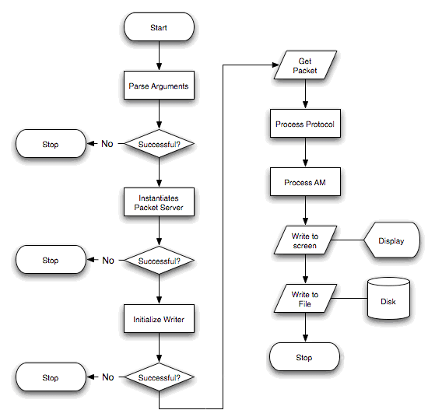
WORKING OF PACKET SNIFFER
reference.2

Slide 14
Working Description
For this Project we are working on linux terminal and programming language used is C.
HEADER FILE :
stdio.h → For Standard things
netinet/ip_icmp.h → Provides Declarations for icmp Header.
netinet/udp.h → Provides Declarations for udp Header.
netinet/tcp.h →Provides Declarations for tcp Header.
netinet/ip.h → Provides Declarations for ip Header.
sys/socket.h → Provides Declaration for the socket used.
arpa/inet.h → Contains Definition of Internet operation.

Slide 15
Socket
A Socket is one endpoint of a two-way communication link between two programs running on a network.
Why do we need a socket:
Packet sockets are used to receive or send packets at the device driver (OSI layer 2) level. Here we are using raw socket as it provides direct access to lower layer protocol such as Ip or ICMP etc.
A raw socket is used to receive raw packets. This means packet received at the ethernet layer will directly pass to the raw socket.

Slide 16
To create a raw socket,
sock_raw = socket(AF_INET , SOCK_RAW , IPPROTO_TCP);
Both reading and writing to a raw socket require creating a raw socket first.
-> Here the first parameter is INET family raw socket. It describe the address the family of the socket. Here we have used AF_INET which is address family constant of Ip version 4.
-> The next parameter passed is the type of the socket. Here we have used SOCK_RAW that is used to define raw socket.

Slide 17
-> The parameter is the protocol of the packet. The protocol number is defined by the Internet Assigned Numbers Authority(IANA).
We have to aware of the family of the socket; then we can only choose a protocol.
Here we have used IPROTO_TCP .i.e. our sniffer will currently only catch the TCP packets.

Slide 18
recvFrom() method :-
data_size = recvfrom(sock_raw , buffer , 65536 , 0 , &saddr , &saddr_size);
-> The recvfrom() function reads the incoming data and capture the address from which the data was sent.
-> It is present in socket module that helps us to receive all the data from the socket.

Slide 19
-> From recvfrom() the data is saved in the buffer from where it is passed further to print the data present inside the packet.

Slide 20

OUTPUT

Slide 21
Reference
Tech-Tool (https://www.tek-tools.com/network/all-about-packet-sniffers)
Flowchart Diagram (https://www.researchgate.net/figure/Process-flow-chart-for-the-Sniffer-application-The-header-and-trailer-are-defined-as_fig3_280659686)

Slide 22
THANK YOU

